Slide 1


2026 1st Annual Pink Ribbon 100
Cross Country Challenge
A Sanctioned Event By The Sport Air Racing League
This is a benefit event to support the works of:
Keepers of the Flame Foundation.
www.togetherweweather.org

Slide 2
Emergency and non-Standard
Radio Calls
Abort – This is a non-emergency call. Make your radio call on present frequency; get safely on the ground, give position if you can. Call Race Central for assistance as needed. Race continues for all other racers.

Slide 3
Emergency and non-Standard
Radio Calls
Mayday – Emergency Only. Make your Mayday call on the current frequency. Get safely on the ground and report your position if able. The following aircraft please remain overhead to locate the landing site and assist directing emergency crews. The aircraft ahead should turn back to help determine their position, remain overhead, and direct rescue crews. Other aircraft should relay the emergency through alternate race frequencies. All remaining aircraft must slow to cruise power, climb as desired, turn to the inside of the course, and return to KRVJ. The race will be officially terminated.

Slide 4
Hazards
Local airport traffic
Power lines
Communications towers
Turn points are airports please be mindful of there local traffic. It is recommended to be 200-300 feet above pattern altitude for the turn point.

Slide 5
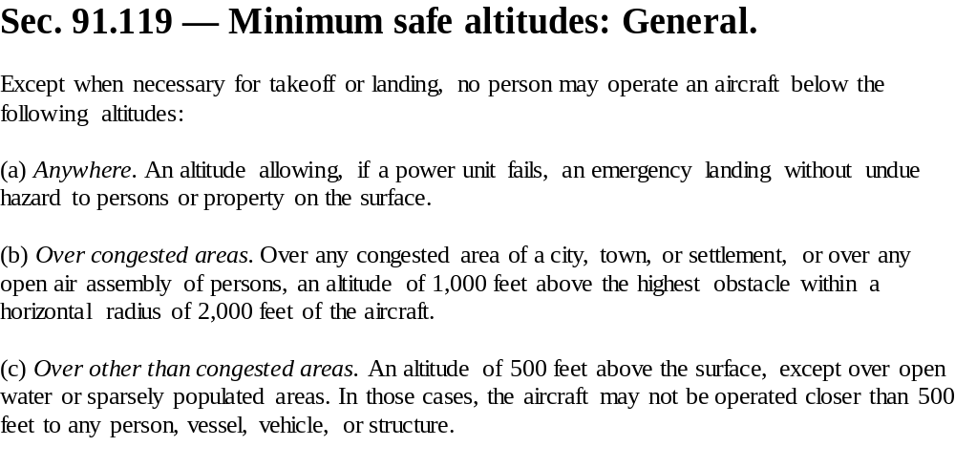
FAR says……

Slide 6
Ground Operations & Departures
KRVJ 122.90 AWOS 128.325
Ground control will set the starting order prior to taxi for departure.
Aircraft will taxi in order as briefed after cleared to taxi by ground control.
Racers will be launched about every 30 seconds by the starter.

Slide 7
Race Start Radio Call
This event we will be using a rolling start for timing. At your start as you begin your takeoff roll call your race number “Rolling”
After departure from KRVJ please proceed direct to first turn point monitoring 122.9 for in coming traffic.
The minimum recommended safe altitude for this event is 1500 AGL.

Slide 8
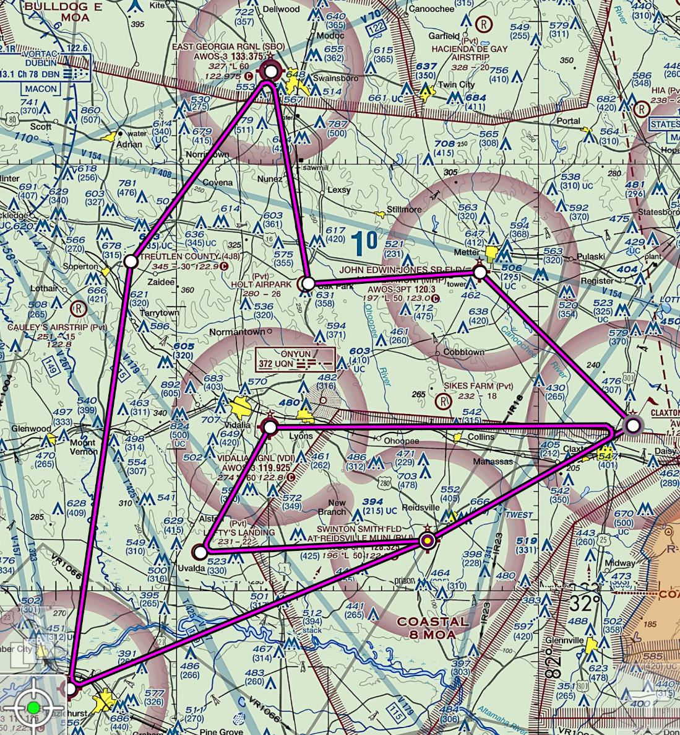
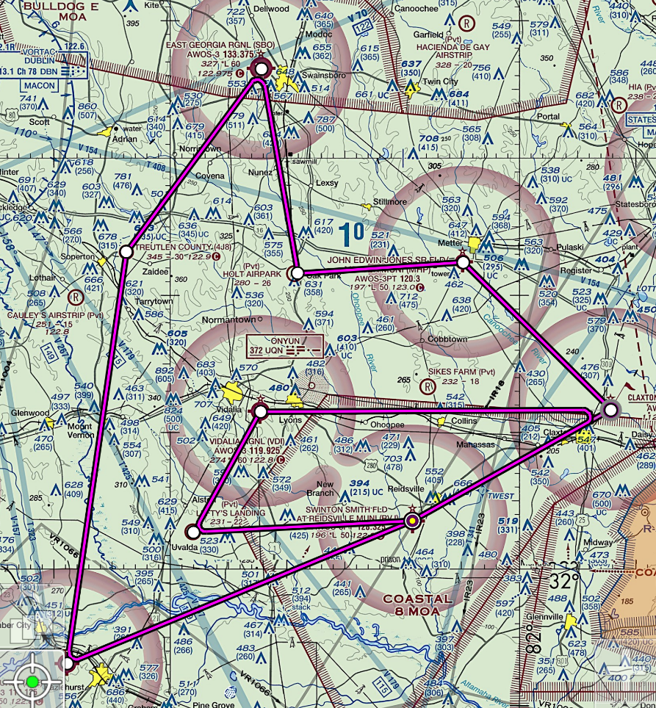
Race Course

Slide 9
Race Frequencies Long course
Start | KRVJ | Riedsville Swinton Smith Field | 122.900
Turn 1 | KCWV | Claxton-Evans Co. | 122.800
Turn 2 | KMHP | Metter Municipal | 123.000
Turn 3 | 13GE | Holt Airpark | 123.450
Turn 4 | KSBO | East Georgia RGNL | 122.975
Turn 5 | 4J8 | Treutlen Co. | 122.900
Turn 6 | KAZE | Hazlehurst | 122.800
Finish | KRVJ | Riedsville Swinton Smith Field | 122.900

Slide 10
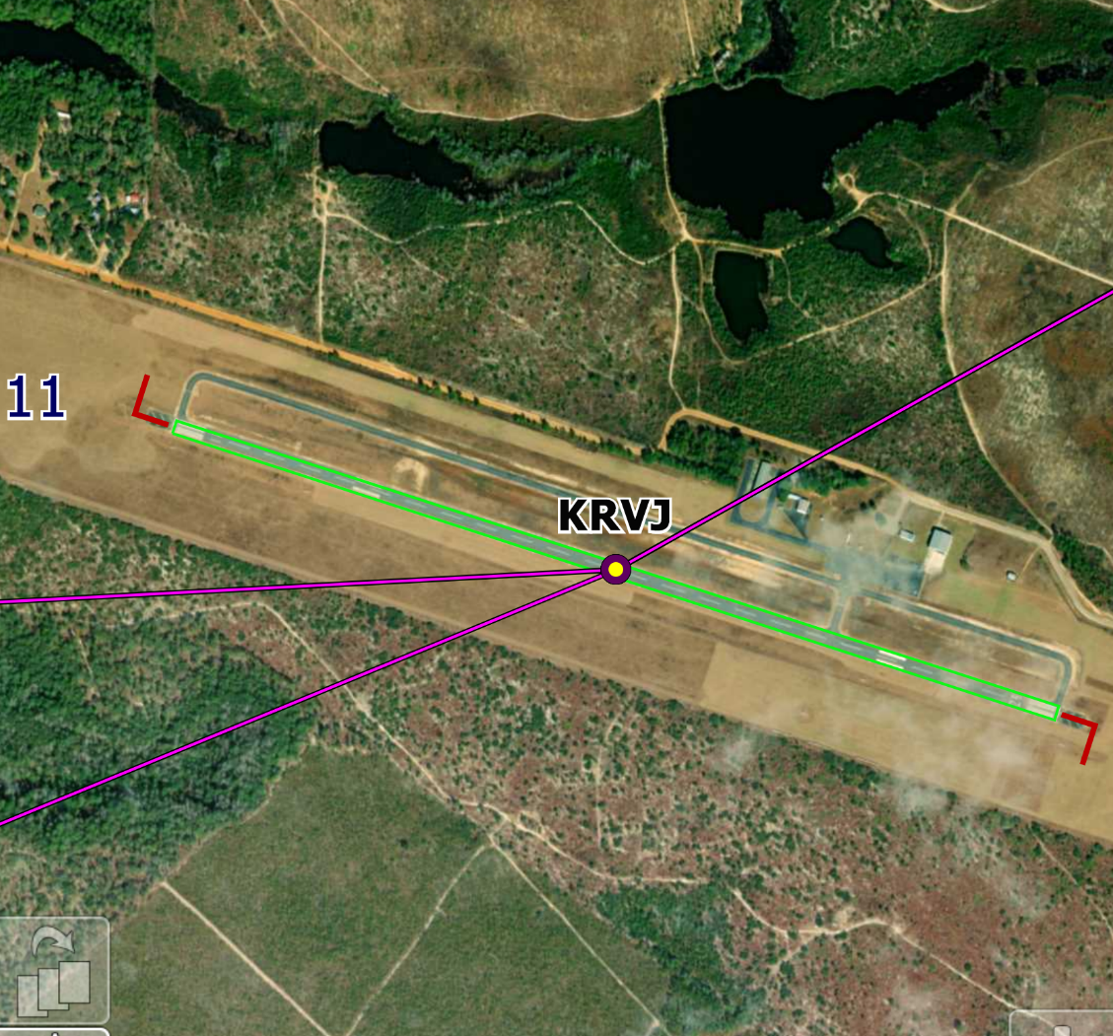
The Start at Reidsville Swinton field (krvj) 122.900 at 30 second intervals or at the direction of the starting official. 122.90

Slide 11
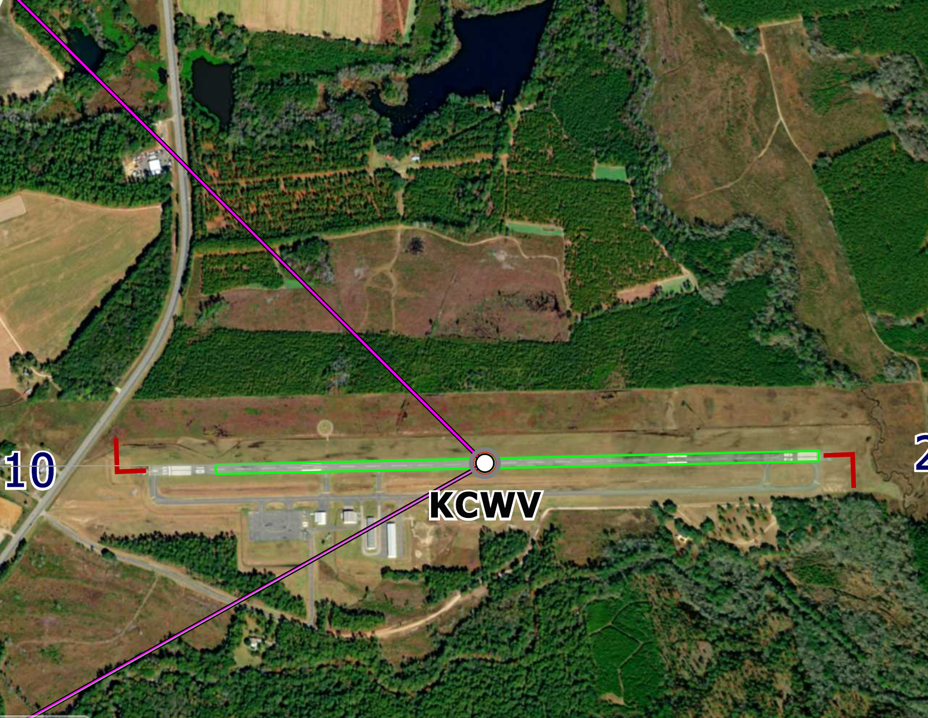
Turn 1 Claxton-evens co. (kcwv) 122.800 your Turn point is mid-field.

Slide 12
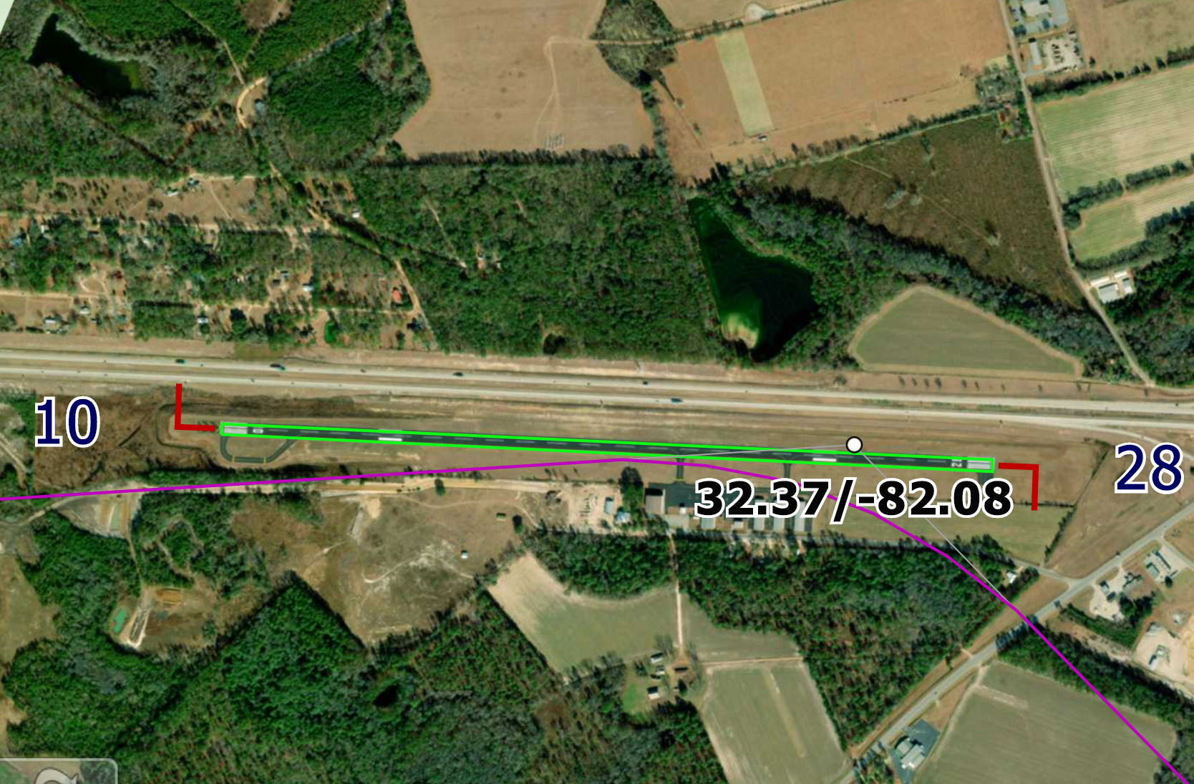
Turn 2 Metter muni (kmhp) 123.00 Your turn point is the mid-field taxiway in front of the main hanger.

Slide 13
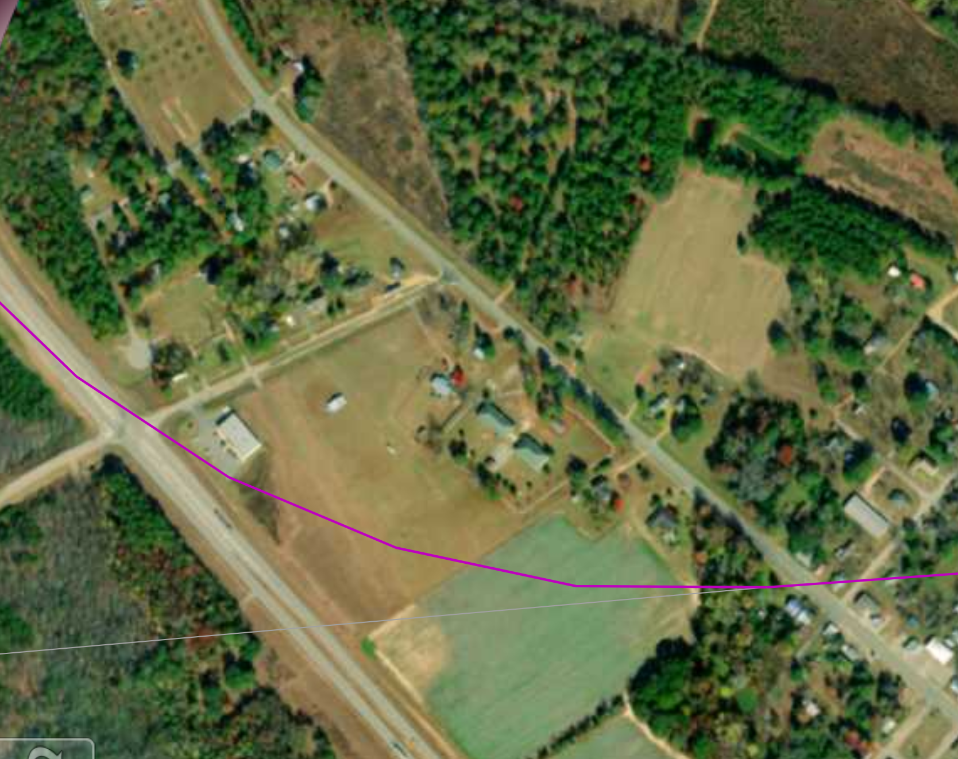
Turn 3 Holt Field (13ge) 123.450
Your turn point is the intersection in front of the building on the corner.

Slide 14
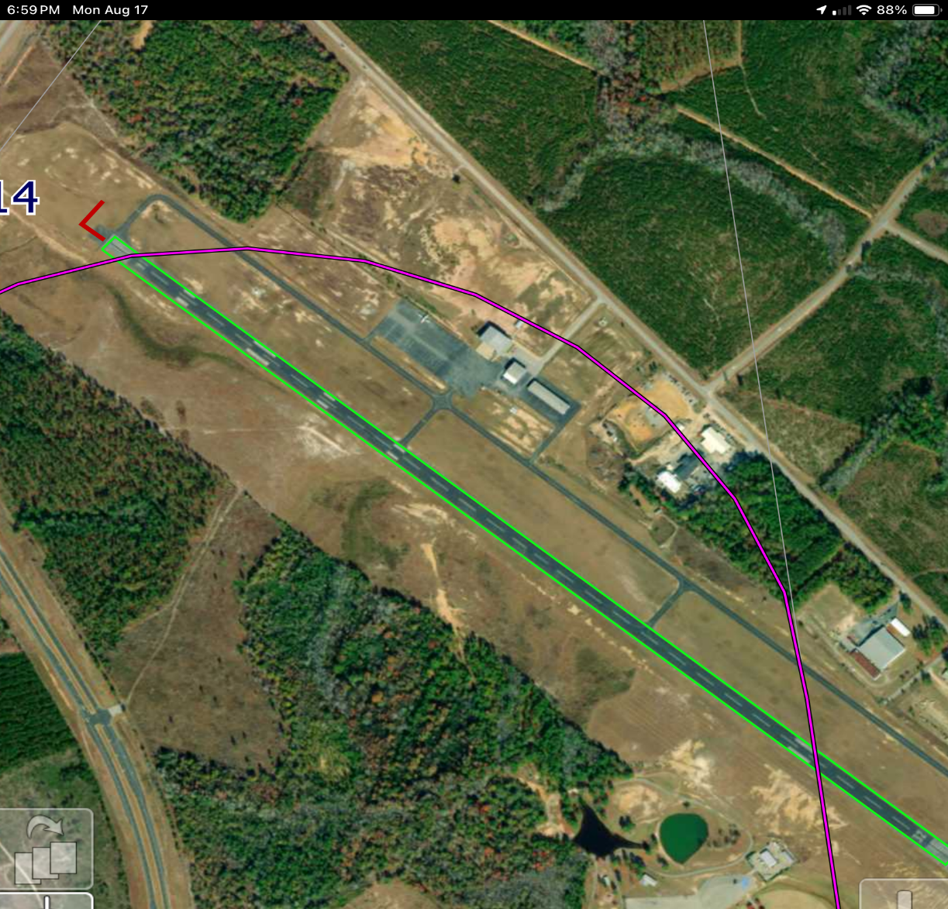
Turn 4 East Georgia rgnl (ksbo) 122.975
Your turn point is from end of runway to end of runway.

Slide 15
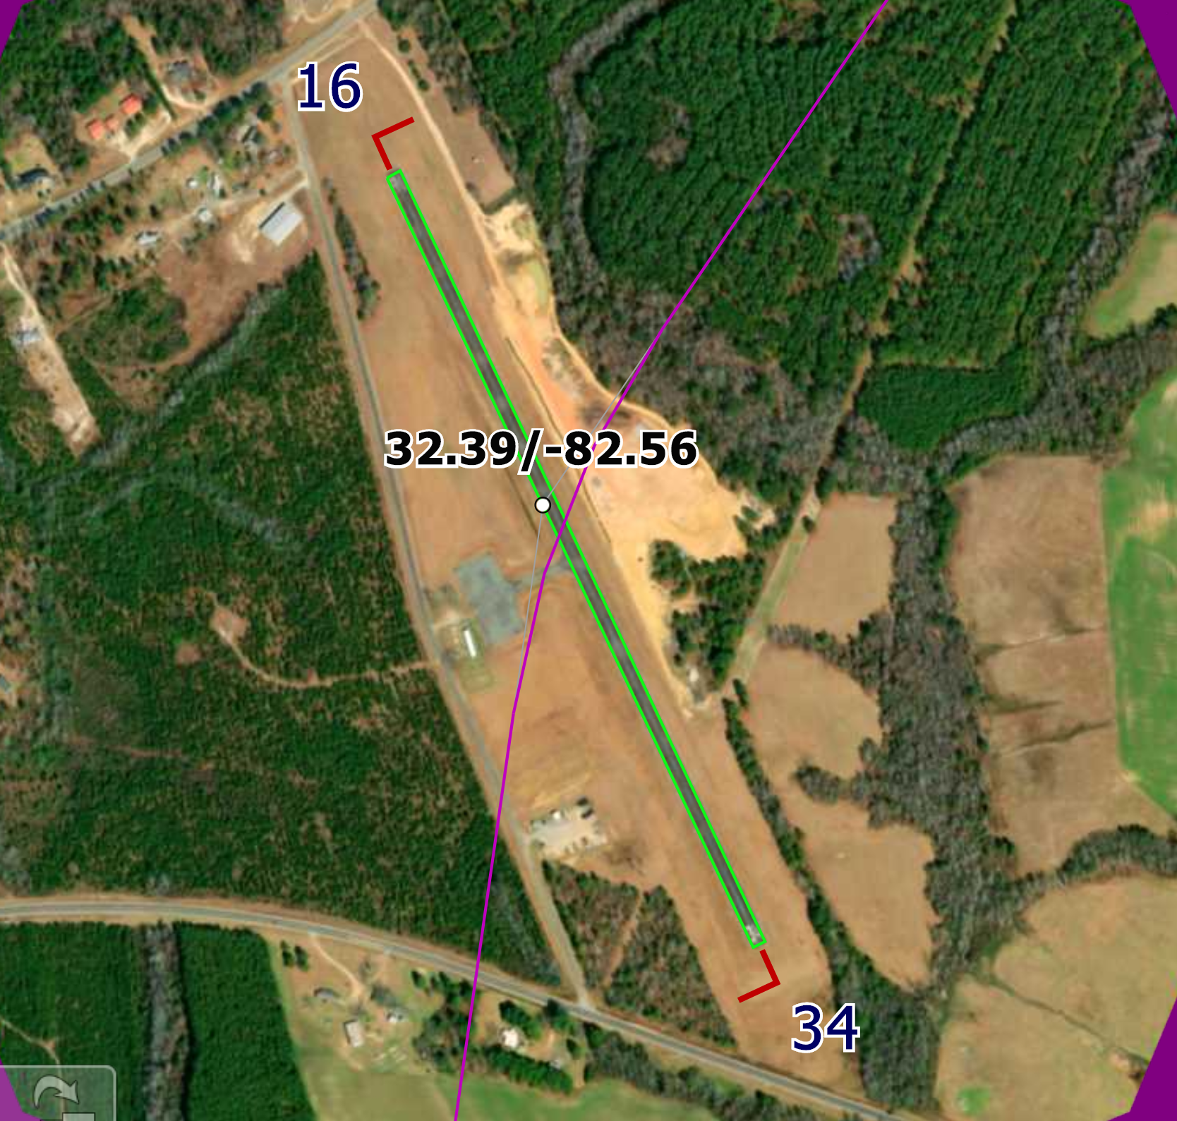
Turn 5 Treutlen Co. (4j8) 122.900 your turn point is mid-field.

Slide 16
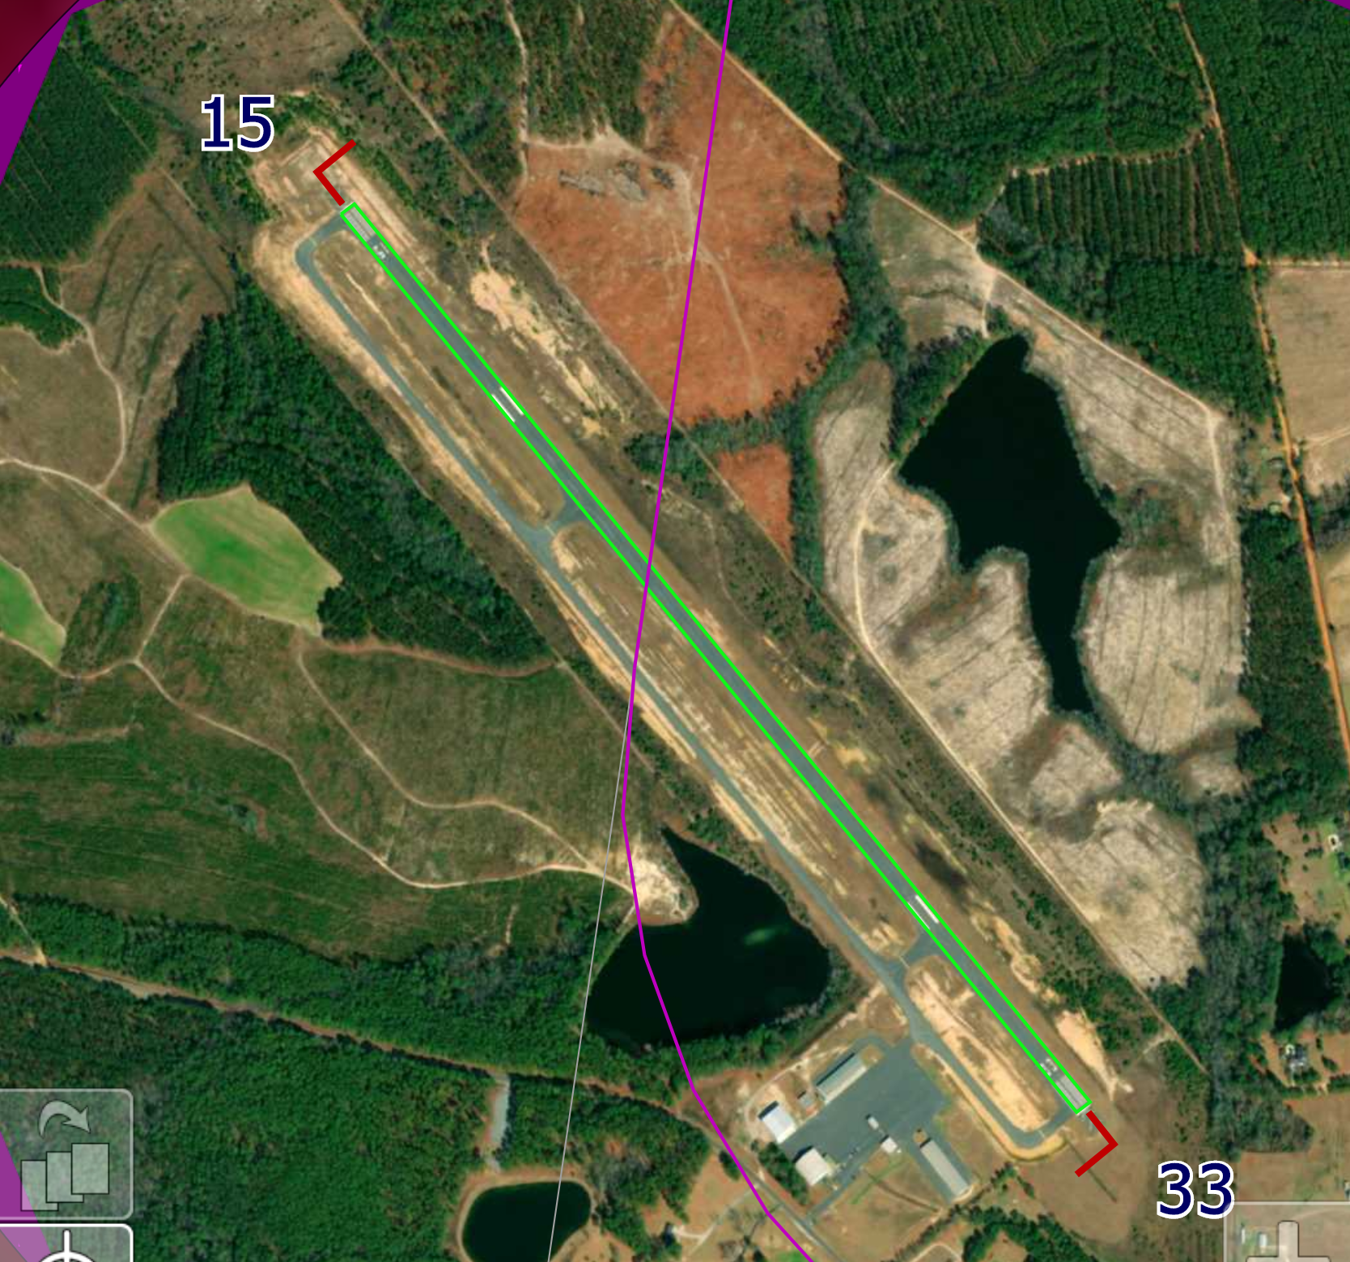
Turn 6. Hazlehurst (kaze) 122.800 Fly Parrell to the runway turning mid-field.

Slide 17
The Finish line at Reidsville Swinton field (krvj) 122.900
Call race number 5 miles from finish and again as you are passing mid field for the finish.

Slide 18
Race Frequencies Short course
Start | KRVJ | Riedsville Swinton Smith Field | 122.900
Turn 1 | KCWV | Claxton-Evans Co. | 122.800
Turn 2 | KVDI | Vidalia RGNL | 122.800
Turn 3 | 18GE | Lefty’s Landing | 122.900
Finish | KRVJ | Riedsville Swinton Smith Field | 122.800
 |  |  | 78.4NM

Slide 19
The Start at Reidsville Swinton field (krvj) 122.900 at 30 second intervals or at the direction of the starting official. 122.90

Slide 20
Turn 1 Claxton-evens co. (kcwv) 122.800 your Turn point is mid-field.

Slide 21
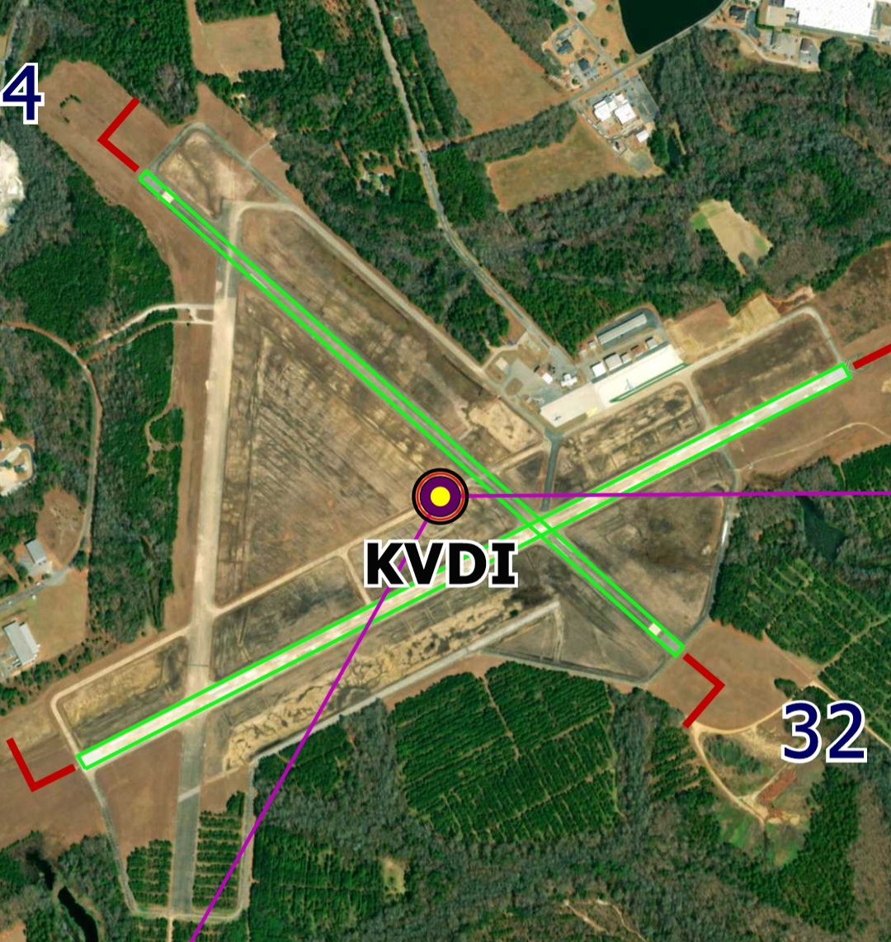
Turn 2 vidalia rgnl (kvdi) 122.800 Your turn point is mid-field center of runway 14/32.

Slide 22
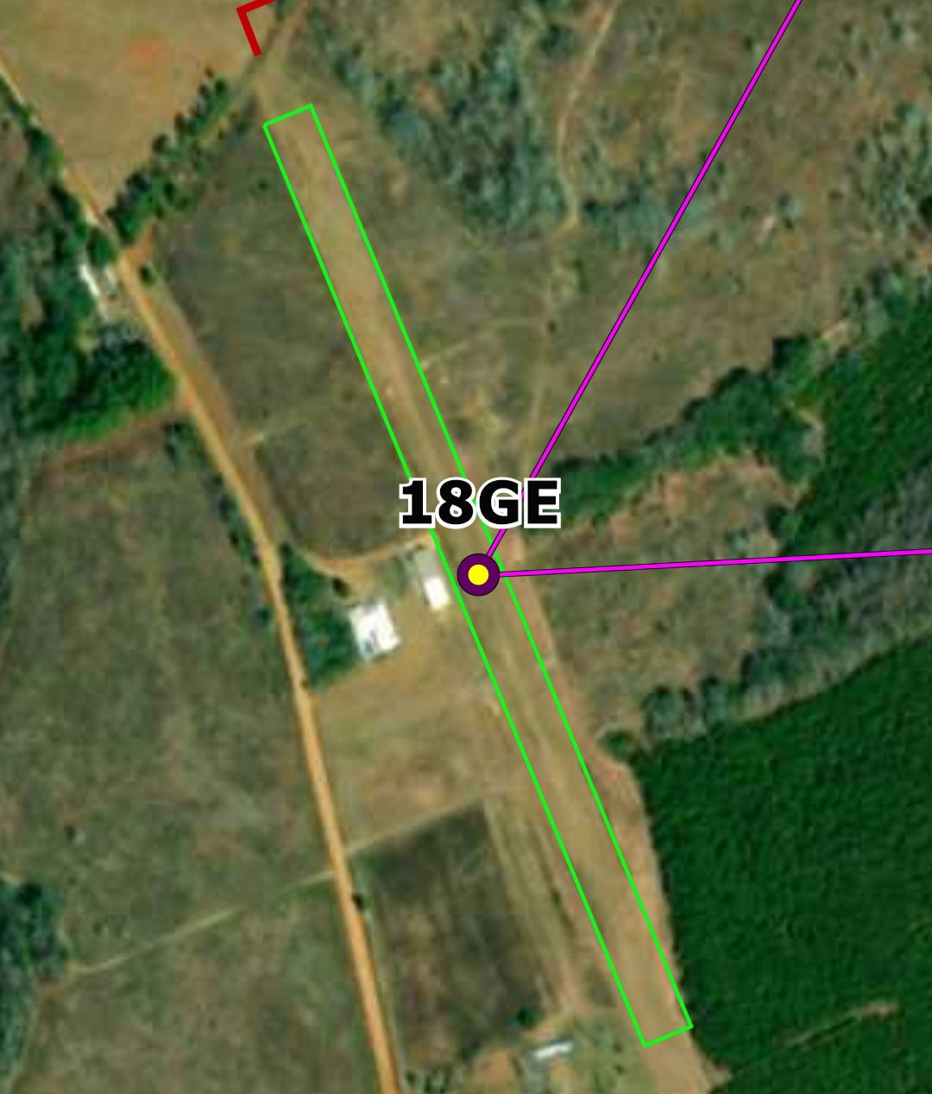
Turn 3 Lefty’s landing (18ge) 122.900
Your turn point is the Runway center.

Slide 23
The Finish line at Reidsville Swinton field (krvj) 122.900
Call race number 5 miles from finish and again as you are passing mid field for the finish.

Slide 24
Landing Procedure
Enter normal traffic pattern for landing at KRVJ
You may do a Victory Pass if you wish, please make that pass on the parallel grass runway. Be sure you follow the normal traffic flow.

Slide 25
Safety Protocol
1. Be Safe – Have Fun
2. You are Pilot in Command – Fly per FARs
3. Passing: - Announce Intentions: Call “Race XX passing (aircraft or race #) on your right (or left, as the case may be).”
- Maintain visual at all times.
- ALWAYS pass on the outside of Turns

Slide 26

A Special Thank You from the sport air racing league and the Reidsville airport authority.

Slide 27
GPS Course Layout

Slide 28
The Pink Ribbon Challenge Weekend Schedule
Friday Oct, 23, 2026
7:00-9:00 Meet and greet dinner at Gigi’s in Reidsville, GA
We will offer shuttle service to and from the Airport and hotel.
Saturday Oct, 24, 2026
8:00-9:45 Registrations.
10:00 MANDATORY Pilot’s Briefing in the FBO
10:45 Pilots to their aircraft.
11:00 The announcement to start engines.
11:10 Begin Race
Lunch will be served as the racers return.
2:00 Awards will be presented
(Weather could extend times but no more than 1 hour. )
HOTELS
The Cottages on Main Street
279 Main Street
Reidsville, GA 30453
912-394-1000 Call directly to get the $150 a night rate and mention the Pink Ribbon Challenge. Space is limited early reservations are recommended.
CAMPING is permitted and welcomed at the airport but is primitive, rest rooms and showers will be available in the FBO.
HOST CONTACT INFO
Richard Kaczmarek
864-426-8191
fastlittleairplanes@gmail.com
THE RACE
Pre-registration is required to participate in this event.
COST: $50 includes Saturday lunch and pilots race t-shirt

